Slide 1
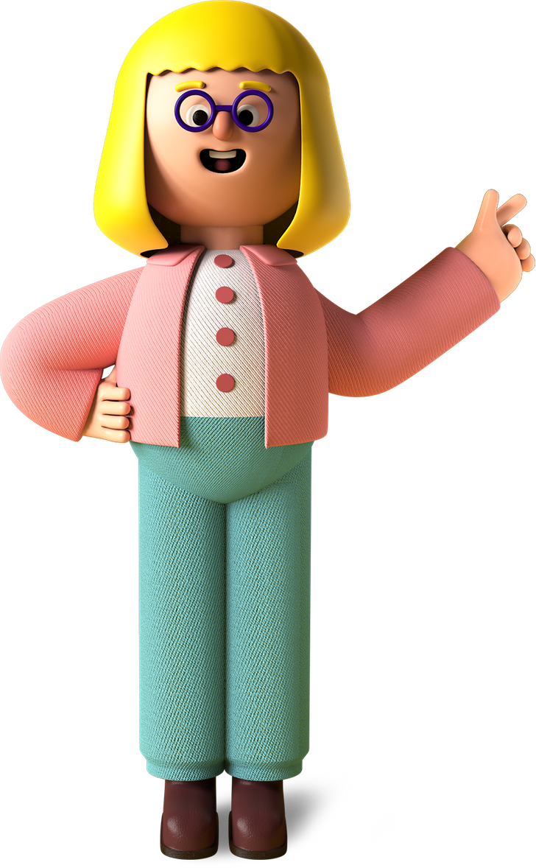
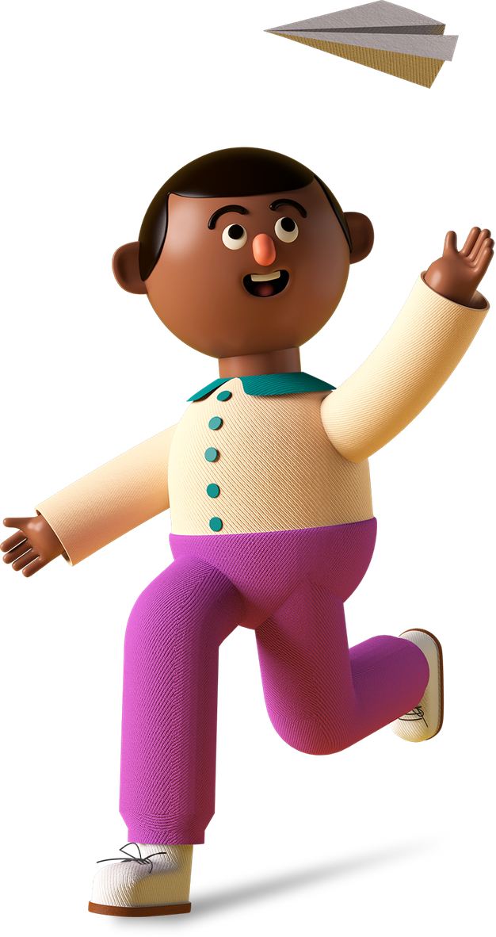
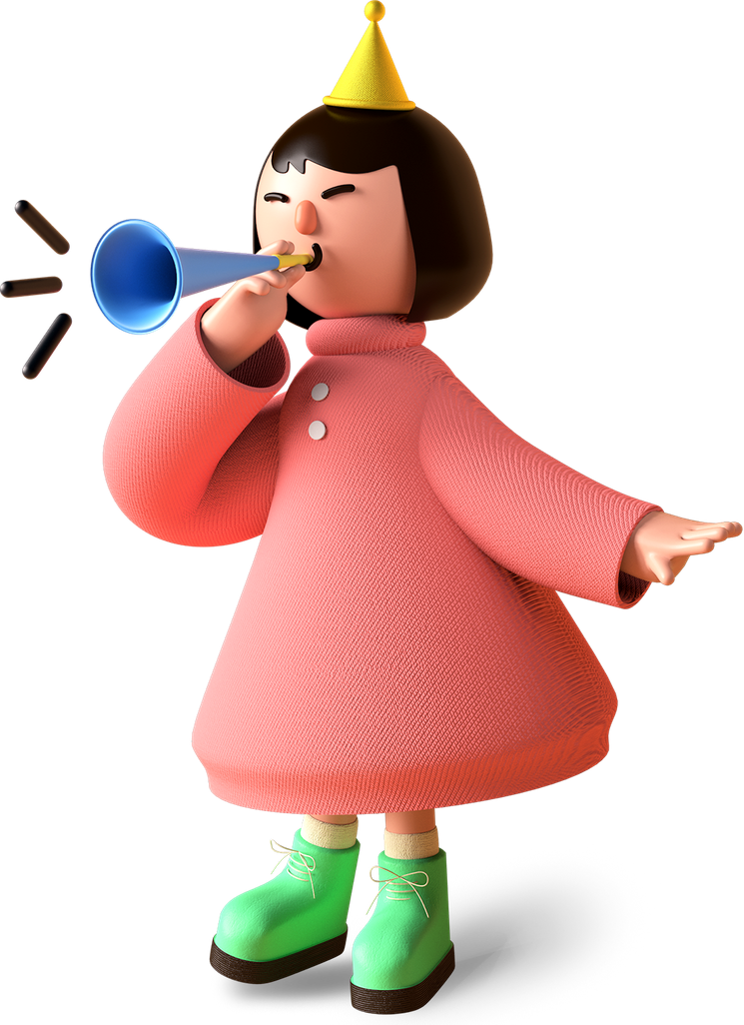
Sparsh’s fav Project

Slide 2

Project Name
Ghost Runner &
Fruit Ninja

Slide 3
Project Link
https://editor.p5js.org/gigoosparsh/full/c65m3uCv1
https://editor.p5js.org/gigoosparsh/full/c65m3uCv1

Slide 4
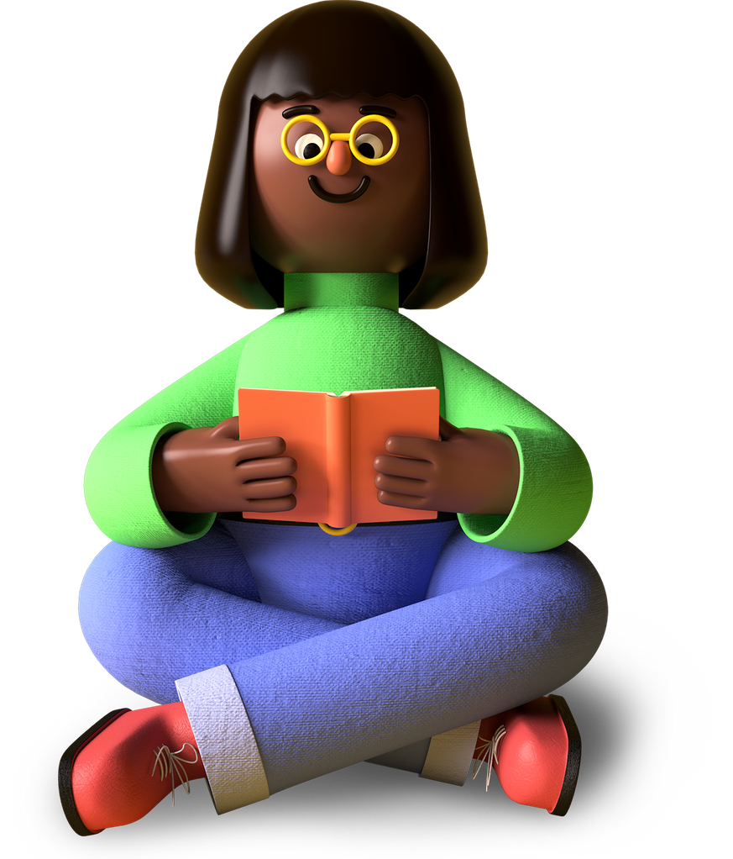
My favorite part about the project
Ghost Runner- Space bar made the ghost jump and background tower image rotation
Fruit Ninja – Fruit cutting sound -swoooshh

Slide 5
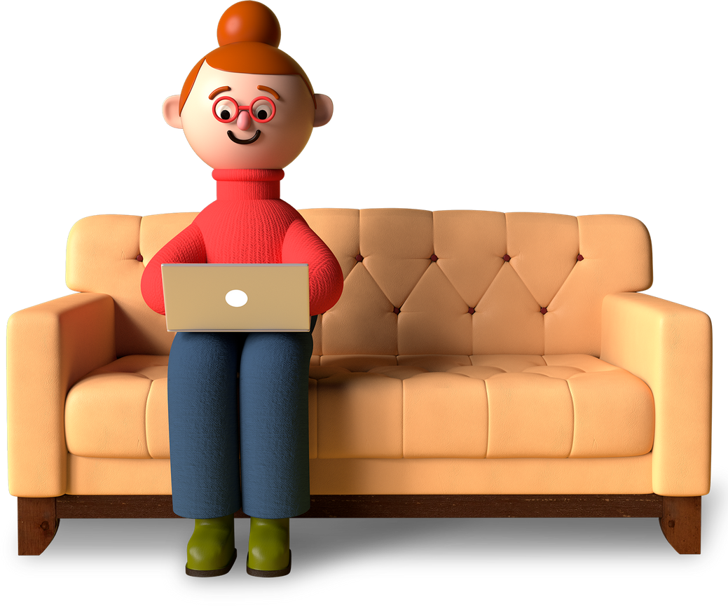
What I learned from it
01
Ghost Runner- How to make endless running game
02
Fruit Ninja- How to destroy and How to apply sound
03
Keep practicing and be persistant

Slide 6
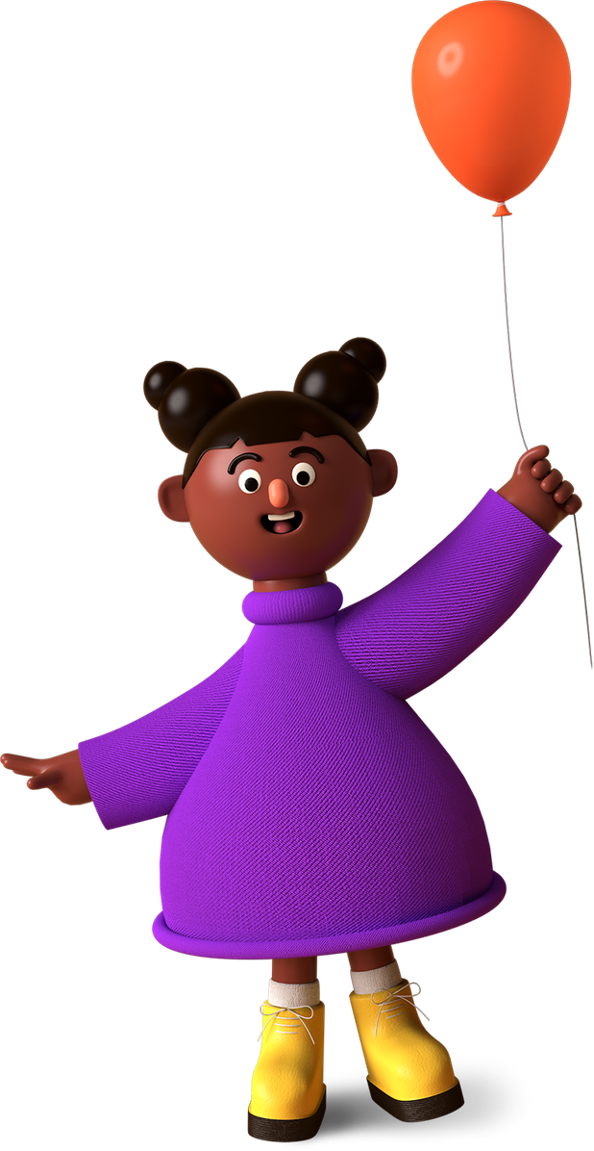
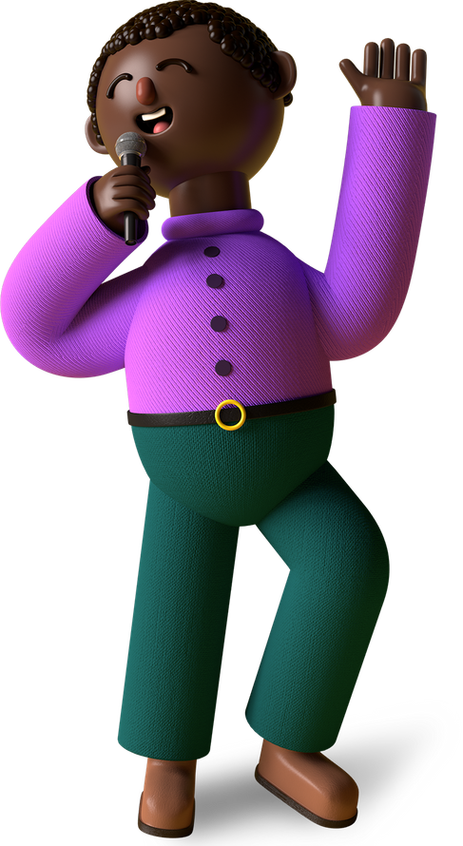
Thank You,
Mumma & Papa
Merry X’Mas & A Happy New Year
From,
Your Sparsh
A Teenage Talented Coder In The Making!

